Slide 1
SELF-ESTEEM
TUNIKI RISHIKESH
20R01A05B2
CSE-B

Slide 2
CONTENTS
What is Self-Esteem
What Self-Esteem is not
Factors that influence’s one’s self-esteem.
Development of self esteem.
Importance of self esteem.
Effects of self-esteem.
Tips on building your self esteem.

Slide 3
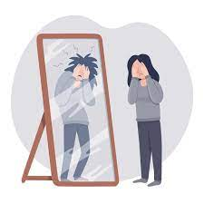
WHAT IS SELF–ESTEEM?
Self Esteem: It refers to the way we see and think about ourselves.
Is the evaluation of one’s success in meeting set goals.
The gap between how you see yourself now and your ideal self.
High self esteem is a good opinion of yourself and low self esteem is a bad opinion of yourself.

Slide 4
WHAT SELF–ESTEEM IS NOT
Self Esteem is NOT dependent upon what other People think of you.
Self Esteem is not egotism, arrogance, selfishness, or a desire to feel superior to others

Slide 5
FACTORS THAT INFLUENCE SELF-ESTEEM
Most factors that affect our self-esteem are:
Media.
Goal Setting ,Self-Talk.
Accomplishment.
Expectations( Realistic vs Unrealistic )
Attitude, Family, Friends.
Your self-esteem is made up of all the experiences and interpersonal relationships you’ve had in your life.

Slide 6
DEVELOPMENT OF SELF-ESTEEM
A person develops his/her self esteem throughout the life through experiences.
In this regard childhood experiences play an important role in shaping self esteem.

Slide 7
FACTORS THAT CONTRIBUTE TO HIGH OR LOW SELF ESTEEM
HIGH SELF-ESTEEM
If you are being praised.
If you are being spoken to respectfully
If you are getting attention
Experiencing success
Having trust worthy friends
LOW SELF-ESTEEM
Experiencing Continuous Failure.
Being expected to perfect all the time.
Being ignored or made fun of
Having physical or emotional punishment.
Being criticized.

Slide 8

IMPORTANCE OF SELF-ESTEEM
High Self Esteem Causes :
Confidence.
Pleasure.
Happiness.
Low Self Esteem Causes :
Depression.
Unhappiness.
Insecurity.
Low Confidence

Slide 9
EFFECTS OF SELF-ESTEEM
People with high self esteem idea’s are shown interest more because others want to hear what they have to say.
They are magnet to positive opportunities.
People with low self-esteem possess
They don’t believe in the themselves
They see themselves failing before they begin.
They have a hard time forgiving their mistakes and make themselves pay the price forever.
They complain and criticize.

Slide 10
TIPS ON BULIDING YOUR SELF-ESTEEM
Think positively.
Believe on your self
Make plans for the future. Set and achieve goals.
Do something for someone else.
Use criticism constructively.
Do not say negative things about yourself
Reward yourself often
Choose friends who value and respect you.
Focus on positive aspects about yourself.
Consider your mistakes learning opportunities.
Accept the things you can’t change, and focus your energy on changing the things you can.

Slide 11
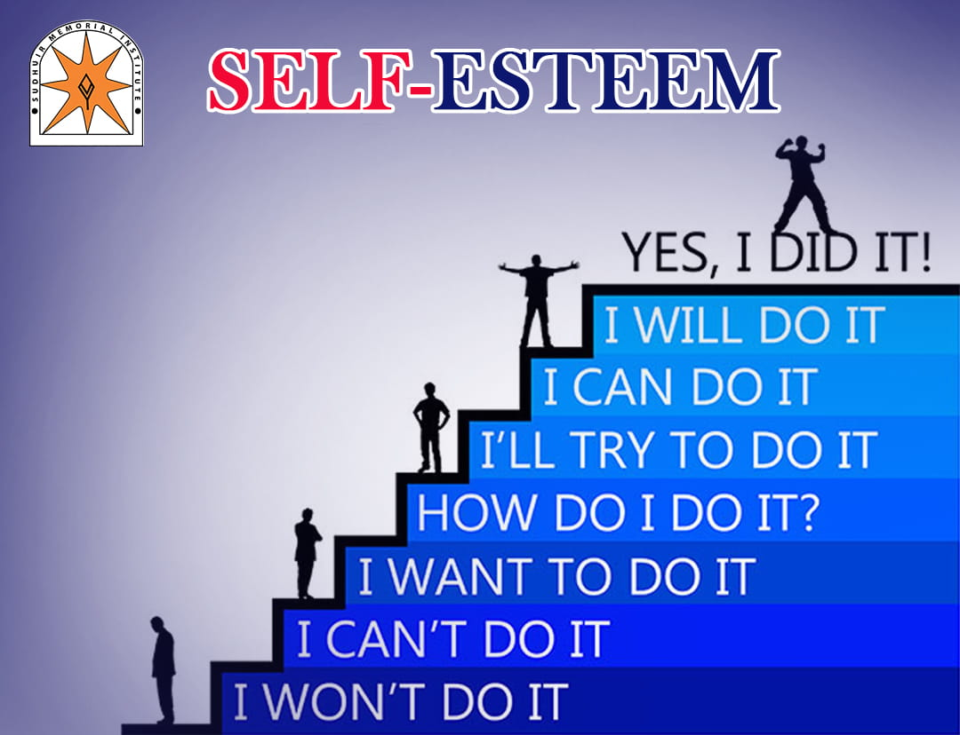
CONCLUSION
I here by conclude that high self esteem is a necessary quality for the one’s benefits.
Low self-esteem can effect one’s life badly, But one can improve self esteem with tips provided.
Good Self Esteem can be a mandatory thing for a better life.

